Slide 1
Easy Appraisal
By Win Ei Khaing

Slide 2
Why?
Our company makes performance appraisal once per year for salary increment and per two years for promotion.
As those are done only by manager in our company, it became a point to blame.
E.g. are you giving favour to someone?
At that time, both employer and employee will not feel good.
Employer must know or view themselves from many points of views(manager view, colleague view and other)

Slide 3
How?
We have to make categories for appraisal (e.g Attendance, Positive Attitudes, Commitment to work, etc.)
If our company has 6 members, each has to be reviewed by other five colleagues.
We have to limit our marking like “0 to 5”, depending on categories.
Review will make weekly.
Can’t change previous marks we gave.
Each can view owned marks but he/she will not be allowed to know who gave.

Slide 4
What we will get?
Depending on the categories we set,
Can know ourselves.
Can find the way to improve.

Slide 5
Technologies
HTML
CSS
Bootstrap 4
Javascript, Jquery, Ajax
.Net Core 3.1
Microsoft SQL server 2019

Slide 6
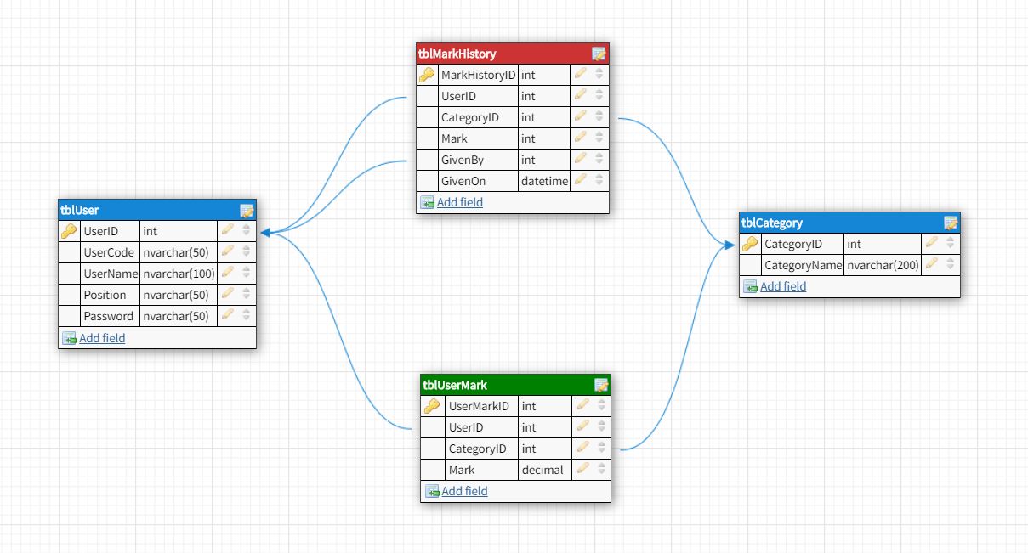
Db Design

Slide 7
About Db Design
tblUser - for all users which will use Easy Appraisal
tblCategory - for all categories which are required for appraisal
tblUserMark - for storing finalized total score for each user
tblMarkHistory - for the history to know who gives how much

Slide 8
System Details
Before system starts,
Create categories in tblCategory.
Create users in tblUser. After a user is created, insert with all categories in tblUserMark.
The system will do
Give marks for others - will update tblUserMark and insert tblMarkHistory
View total scores
For Manager - can view finalized marks of all users
For Non-Manager - can view owned marks

Slide 9
Forms which are used
Login form
Latest Summary Listing form
only for manager to view all users’ total marks
Appraisal form
for both manager and non-manager users
can view owned total mark
can give appraisal marks for other users, except the current login user

Slide 10
Project Schedule
2020-10-21 - db design, prepare master data and Login form, unit testing
2020-10-22 - manager’s Latest Summary Listing form, unit testing
2020-10-23 - Appraisal form, unit testing , integration testing

Slide 11
P.S for overall this system
Now, appraisal count is unlimited, company should have limit for that.
As this current version does not have master data setup, it should be implemented for those master later.
To run in your local after u get source code,
Run database script under 2. Design folder
As I have not registered sql connectionstring in config yet, please change that under 3. Code implementation -> EasyAppraisal_Api -> EasyAppraisal_Api -> DAO ->SQLDbConnecter.cs

Slide 12
Thank You
You all can get project database design, script and all source code on
https://github.com/Win-Ei-Khaing/Easy-Appraisal.git

